Slide 1
Topic: Similar Triangles Eq: How do we know if triangles are similar?
Year 9

Slide 2
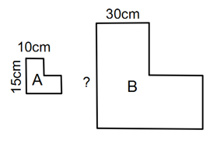
5 questions
Complete last lessons summary.
Find the scale factor of the following shape (B is the original):
Find the missing side for the square B.
What does Point O mean?
What does Similar Triangles mean?
Topic: Similar Triangles Eq: How do we know if triangles are similar?

Slide 3
24
7
30
Similar Triangles
Date
EQ – How do we know if triangles are similar?
What does similar mean?
Similar figures have the same shape, but not necessarily the same size.
Similar Triangles: Same shape but different size
Congruent Triangles: Same shape and same size

Slide 4
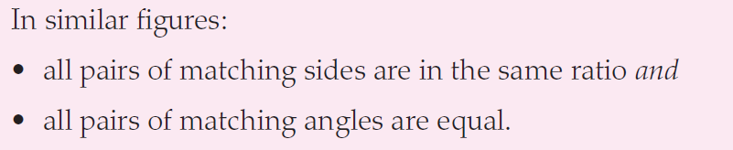
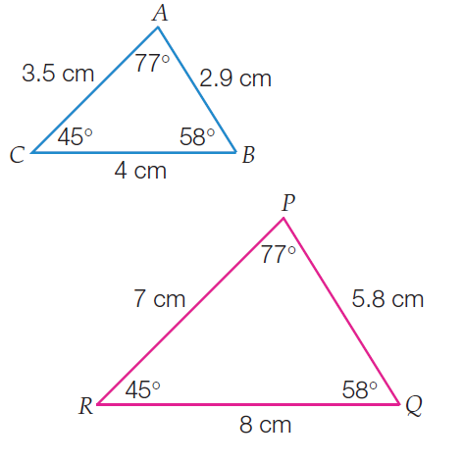
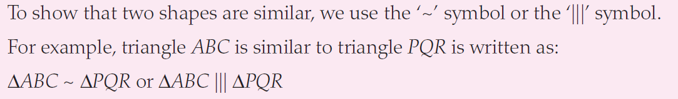
24
7
30
Similar Triangles
Date
EQ – How do we know if triangles are similar?

Slide 5
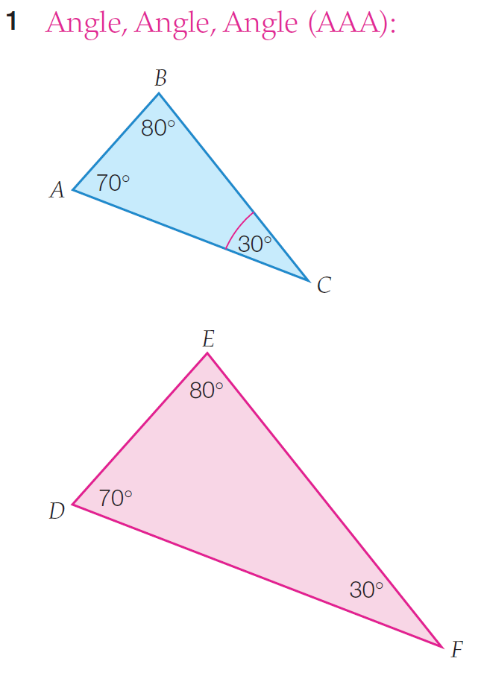
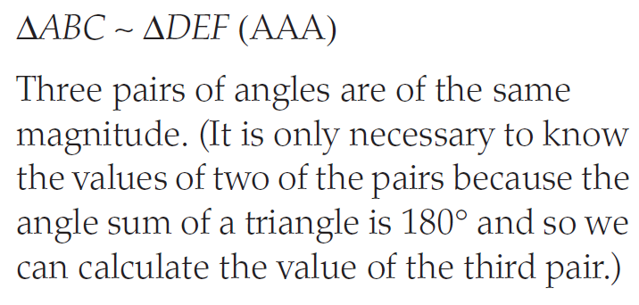
Just like congruency, we can use 4 types of tests to see if the triangles are similar

Slide 6
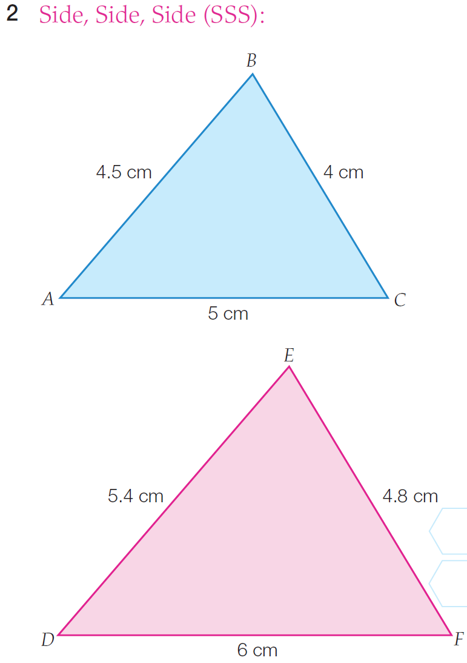
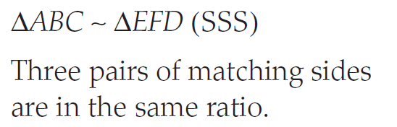

Slide 7
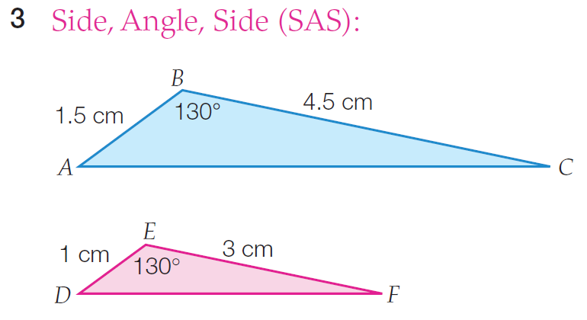
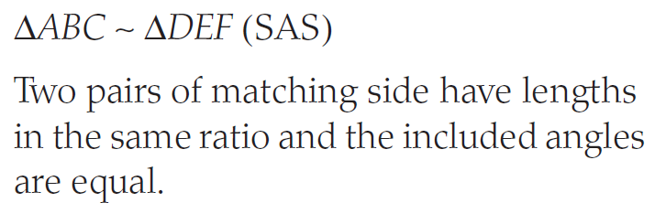

Slide 8
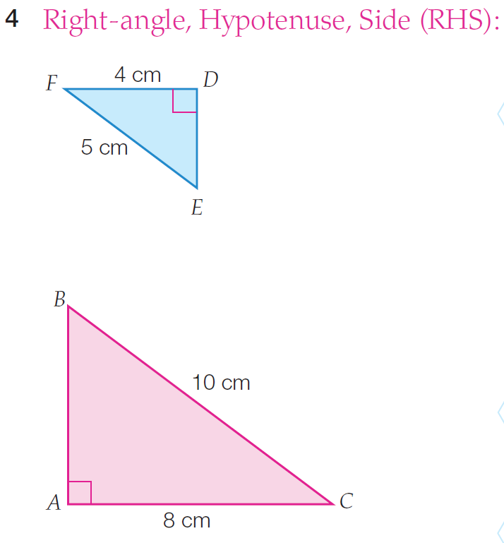
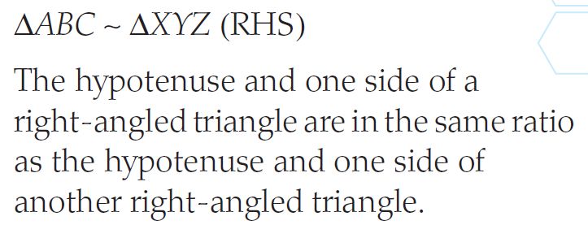

Slide 9
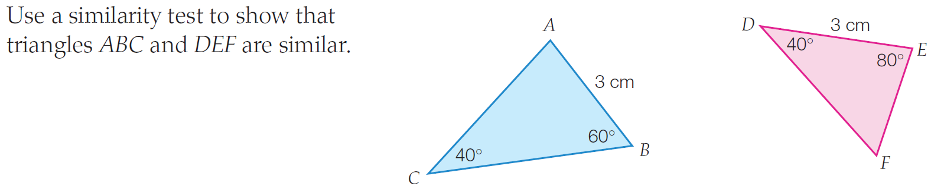
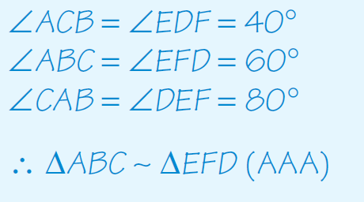
Example 1

Slide 10
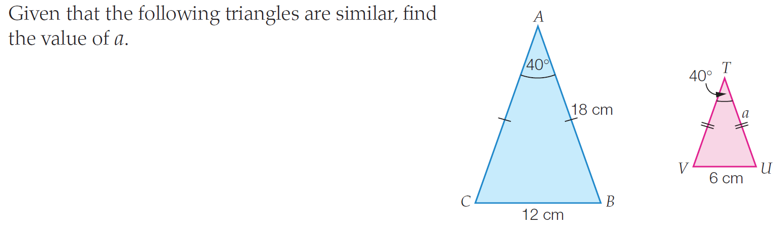
Example 2

Slide 11
You have 3 minutes to write a summary that answers the Essential Question.
Be prepared to share your summary with the people sitting in your row.
Write your summary

Slide 12
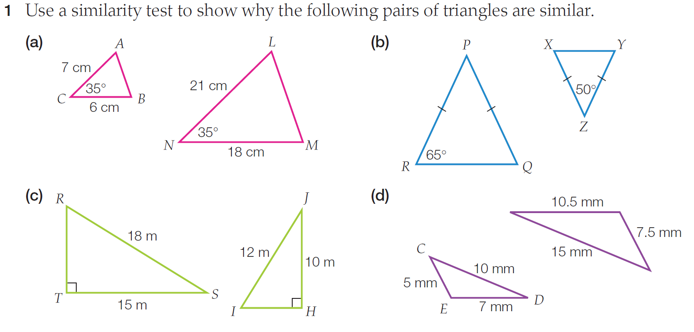

Slide 13
